Slide 1
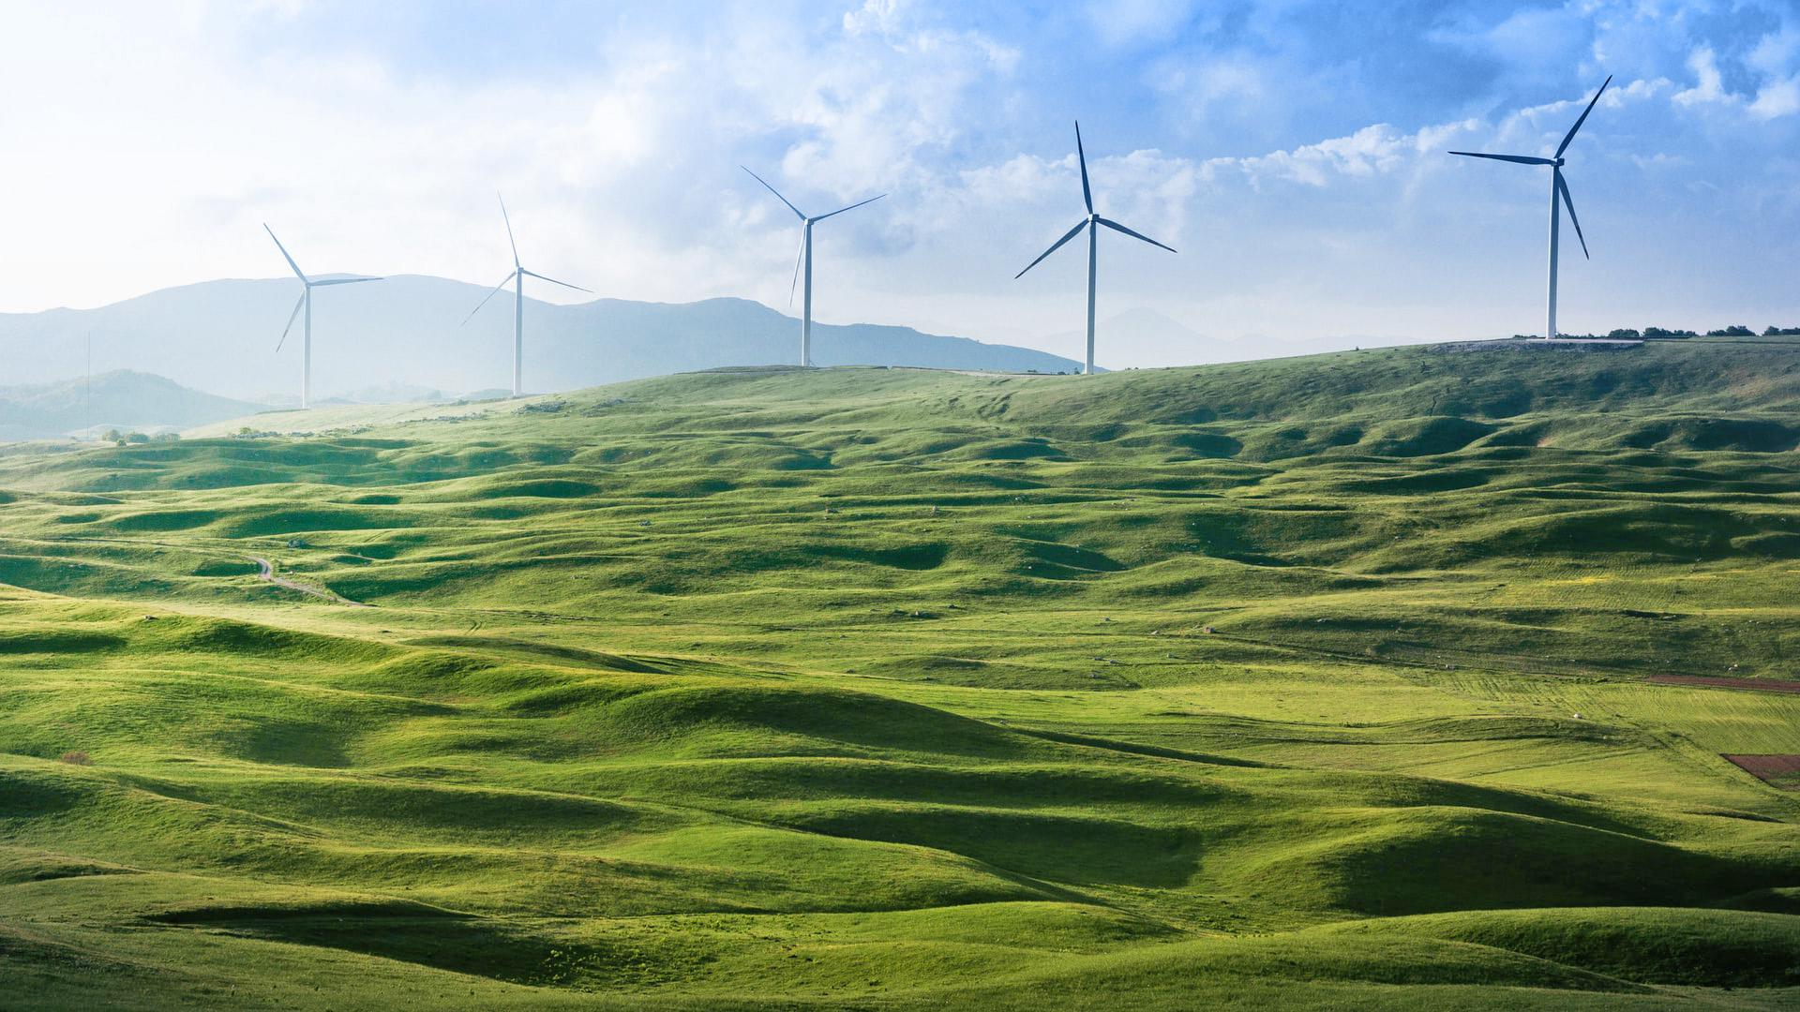
Team Vinci AANBHT06168 AANBAC002 Livestock Ownership Management

Slide 2
ABSTRACT
This is a livestock and farm warehouse management system which dynamically manages the available space in the warehouse and performs stock ownership management.
It provides graphical representation and stock management functions to the manager thus making it easier to update, delete, and store livestock and ownership details. We can graphically visualize available space and occupied space and calculate rent dues and track livestock efficiently.
Livestock owners are unique identified by their UIDAI Aadhaar UID number thus preventing redundancy and enabling easy identification and KYC. This system can be integrated with unique tags attached on livestock (Barcode/RFID) and scanners for better tracking and accurate timestamping functions for cost calculation.
Report generation and data export functionality has been included which useful for auditing and archival purposes in case of Co-Op or availing government schemes/subsidy. Indian government has allocated Rs.1,00,000 Crore under Aatmanirbhar Bharath Scheme for Agriculture infrastructure.

Slide 3
Software Stack
Application
Python 3
Tkinter (GUI)
PyPlot & Matplotlib (Graphing)
MySql-Connector-Python (DB Connection)
Database
MySql Server

Slide 4
Steps Taken for Project Completion
Design
Database designed and architecture finalized
User Interface was designed with ease to use in thought.
Implementation
UI implemented in Python tkinter and DB connected to MySQL server using MySql conector.
Graphs implemented using Pyplot and Matlabplt libraries.
Testing
Cost Function and Date and Time stamping functions tested.
Owner details storage, stock updating, deletion, remaining space calculator and graphing functions tested

Slide 5
Architecture (Connections)
01
02
03
KYC / RFID / BARCODE SCANNER
Front End Application
SQL Server Database
RFID / BARCODE TAG ATTACHED TO LIVESTOCK
(Optional)
Ownership Details,
Cost Details
Graphical Visualization
Data Exported to Excel, CSV

Slide 6
Expected Results
Proper livestock count, space monitoring and stocking /destocking time details stored correctly.
Graphical visualization of plot occupancy, livestock count and storage left
Unique identification of livestock owner and details stored with AADHAR ID which can be used to avail government benefits.
Automatic and accurate storage Fee Calculation.

Slide 7
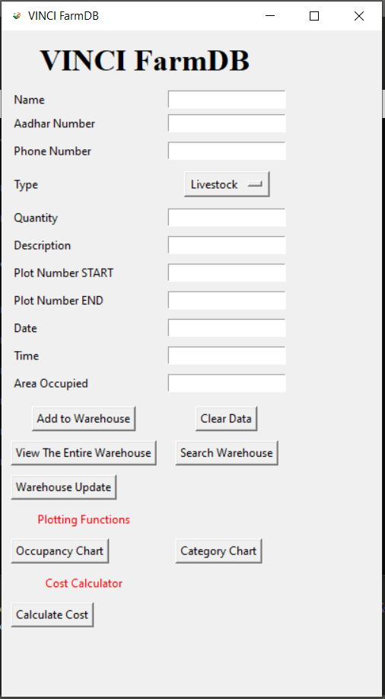
Application Snapshots

Slide 8
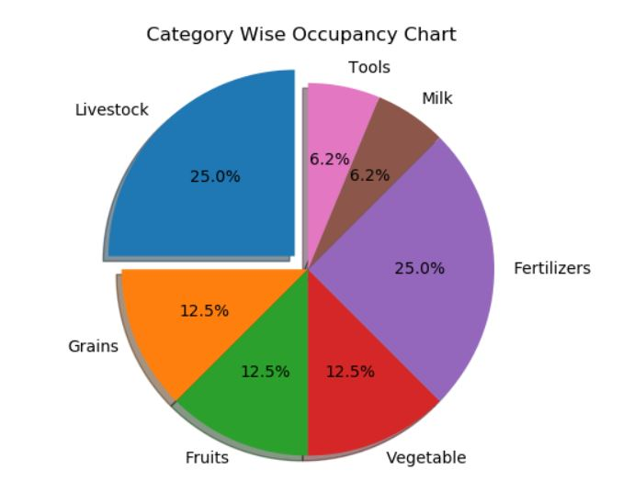
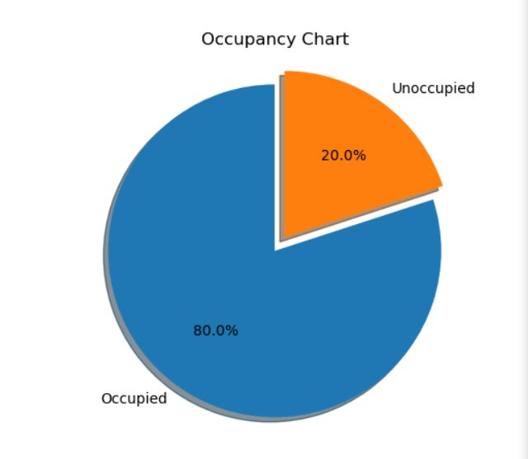
Application Snapshots
Place your screenshot here

Slide 9
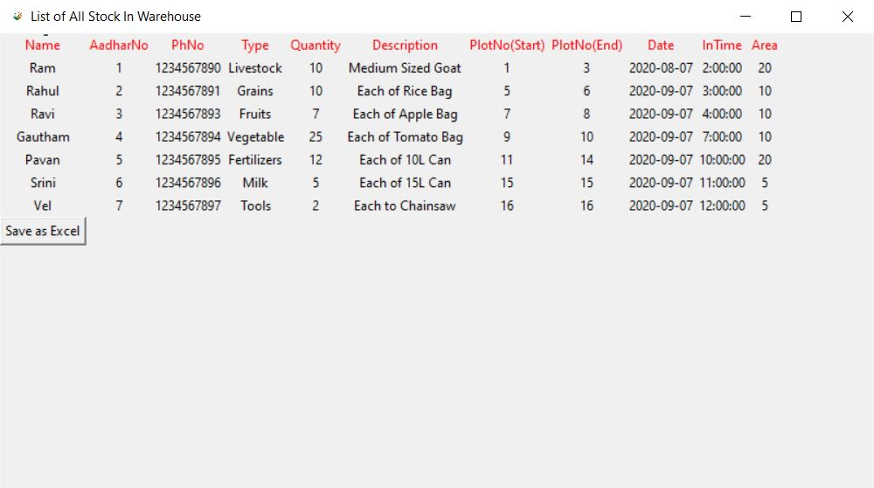
Application Snapshots
Place your screenshot here

Slide 10
Thanks!
Any questions?

